Slide 1

CS 533 INTRO TO DATA SCIENCE
Michael Ekstrand

Slide 2
SINGLE REGRESSION

Slide 3

Learning Outcomes
Model a linear relationship between two variables
Estimate the parameters of this model
Identify the assumptions needed for the model’s inferential validity
Photo by Alessio Lin on Unsplash

Slide 4
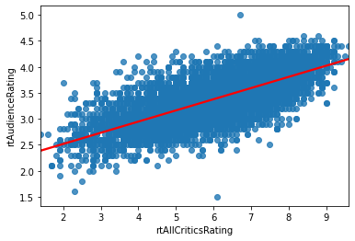
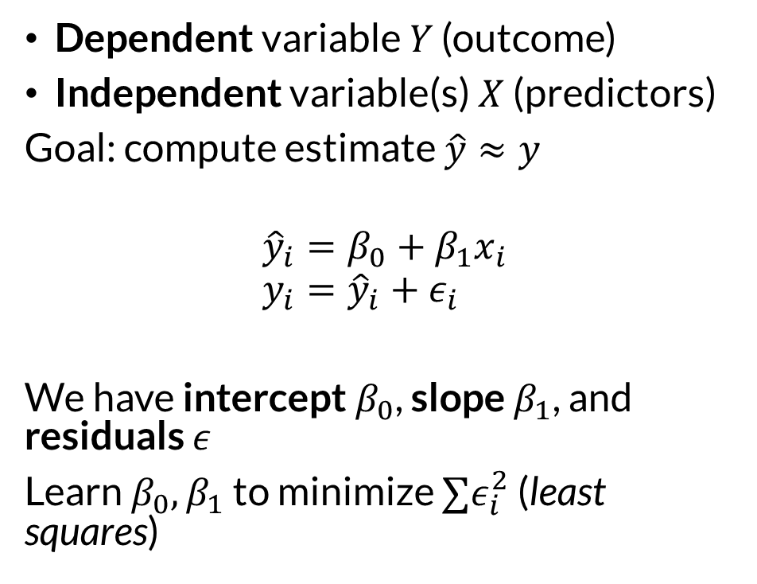
Variables and Model
Dependent variable $Y$ (outcome)
Independent variable(s) $X$ (predictors)
Goal: compute estimate $\hat{y}≈y$
$${\hat{y}}_{i}=β_{0}+β_{1}x_{i} \\ y_{i}={\hat{y}}_{i}+ε_{i}$$
We have intercept $β_{0}$, slope $β_{1}$, and residuals $ε$
Learn $β_{0},β_{1}$ to minimize $∑ε_{i}^{2}$ (least squares)
This is univariate (one-variable) regression

Slide 5
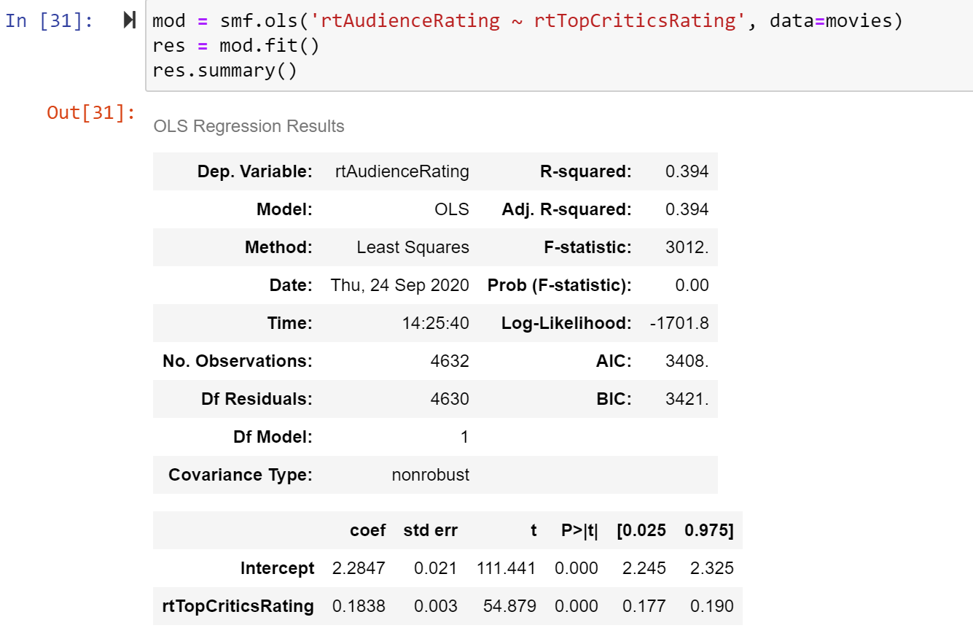
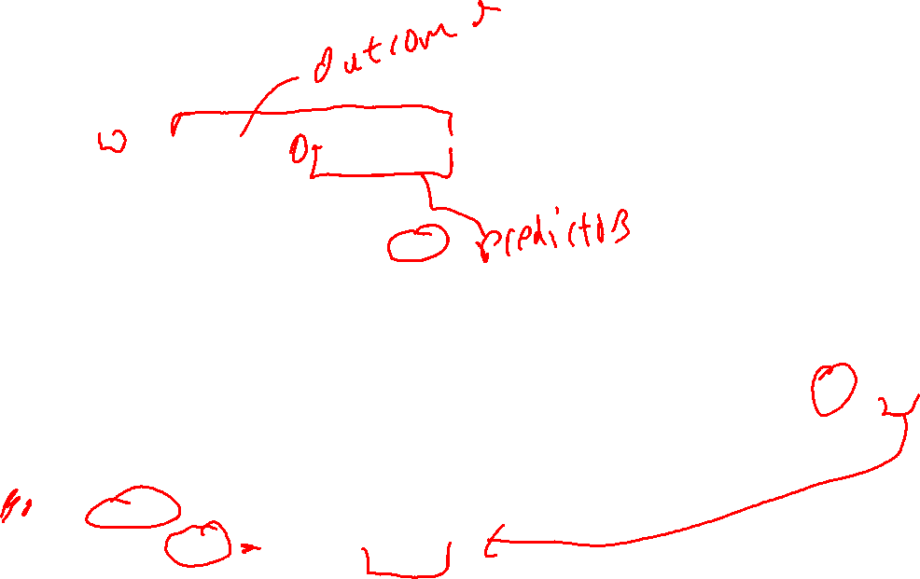
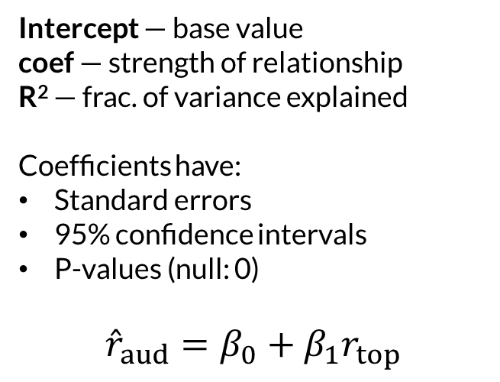
Regression Model
Intercept — base value
coef — strength of relationship
R² — frac. of variance explained
Coefficients have:
Standard errors
95% confidence intervals
P-values (null: 0)
$${\hat{r}}_{aud}=β_{0}+β_{1}r_{top}$$

Slide 6
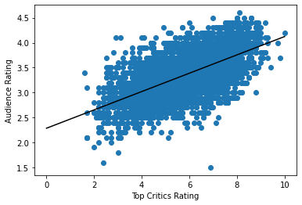
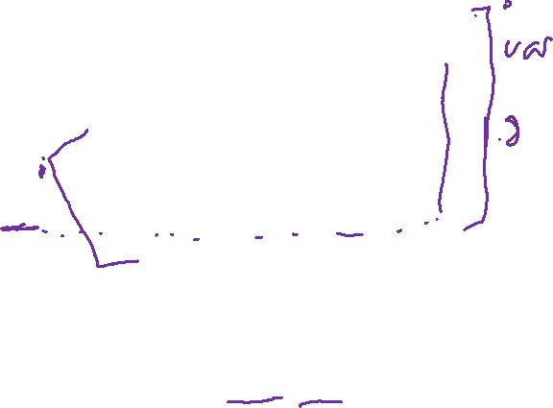
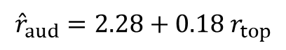
Regression Model
$${\hat{r}}_{aud}=2.28+0.18 r_{top}$$
Note: I have extended this plot to have 0 at the left end of the x axis to highlight the intercept. Intercept is where the line crosses 0, not where it crosses the left Y axis.

Slide 7
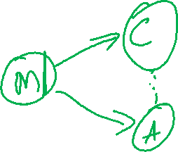
DGP
Movie: *exists*
Critics: this is ok, I guess
Audience: 👏
Critic ratings do not cause audience ratings
Relationship does not need to imply causality

Slide 8
Fitting Lines
We can (almost) always fit a line
Resulting line is least squares
Can be used to predict
Inference makes assumptions:
Linear relationship
Independent observations
Normal residuals
Equal variance of residuals
Result: residuals are i.i.d. normal

Slide 9
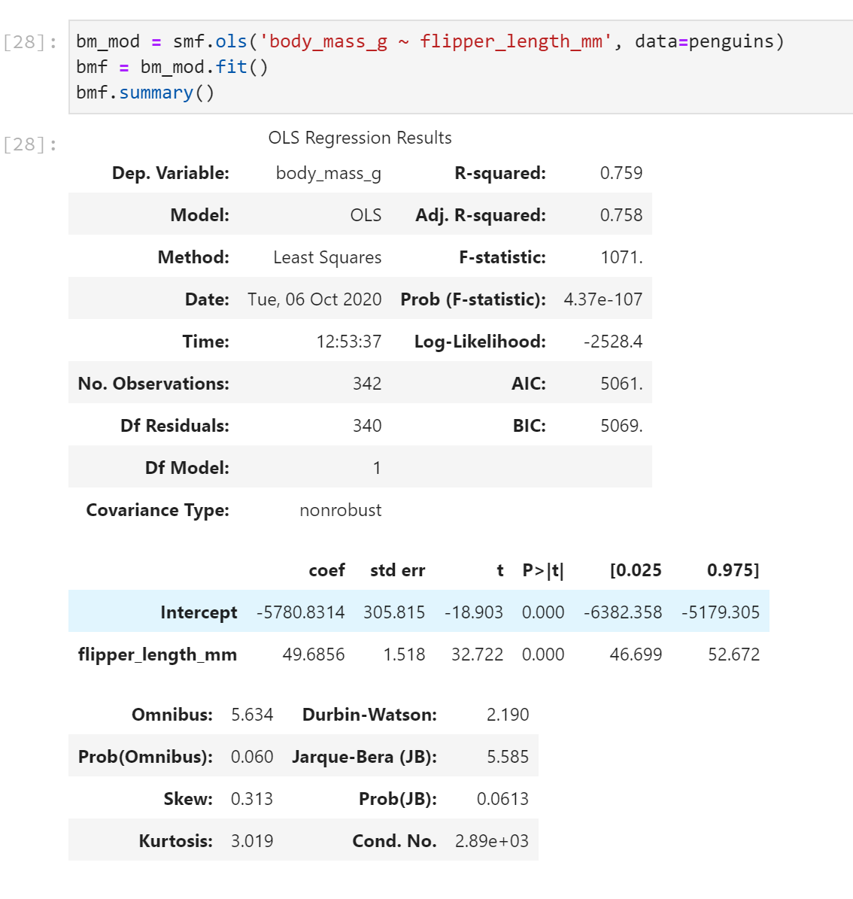
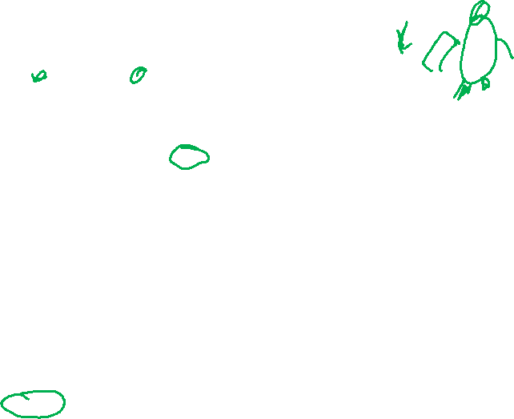
Penguins
Explains 76% of variance
1mm flipper ⇔ 49.7g mass
Stats models warns us about condition number – not actually a problem here. But we can still make it go away.

Slide 10
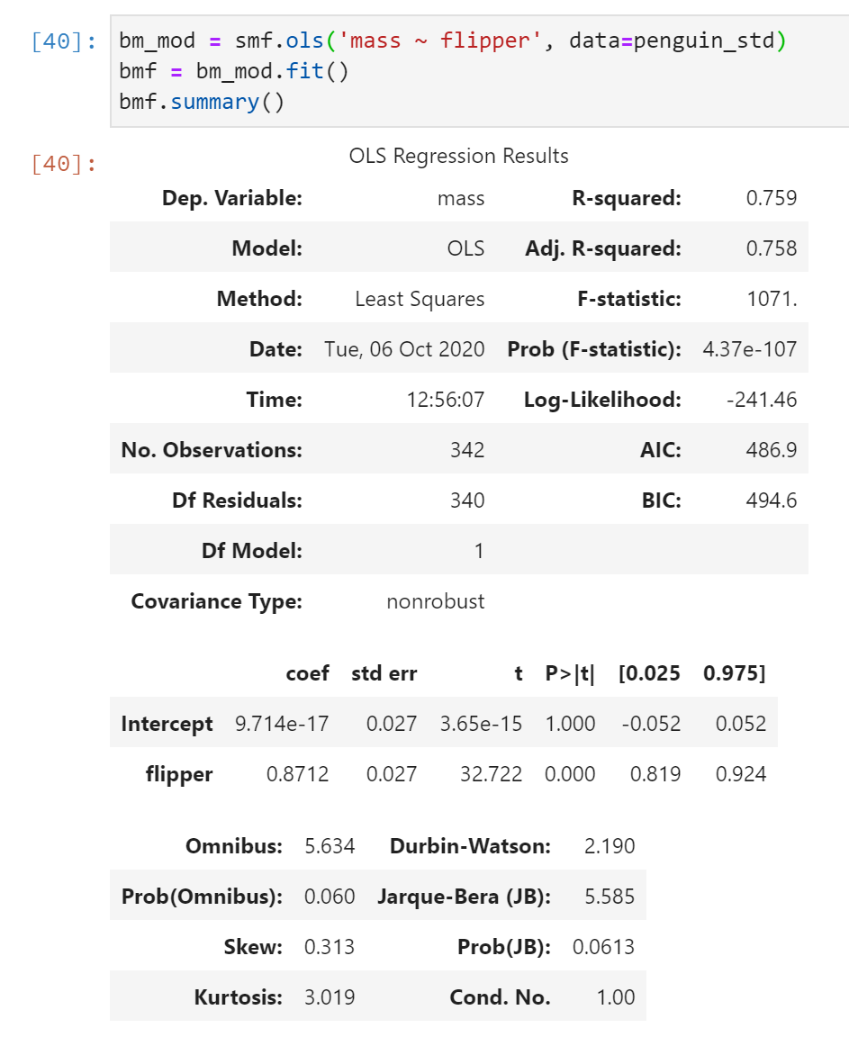
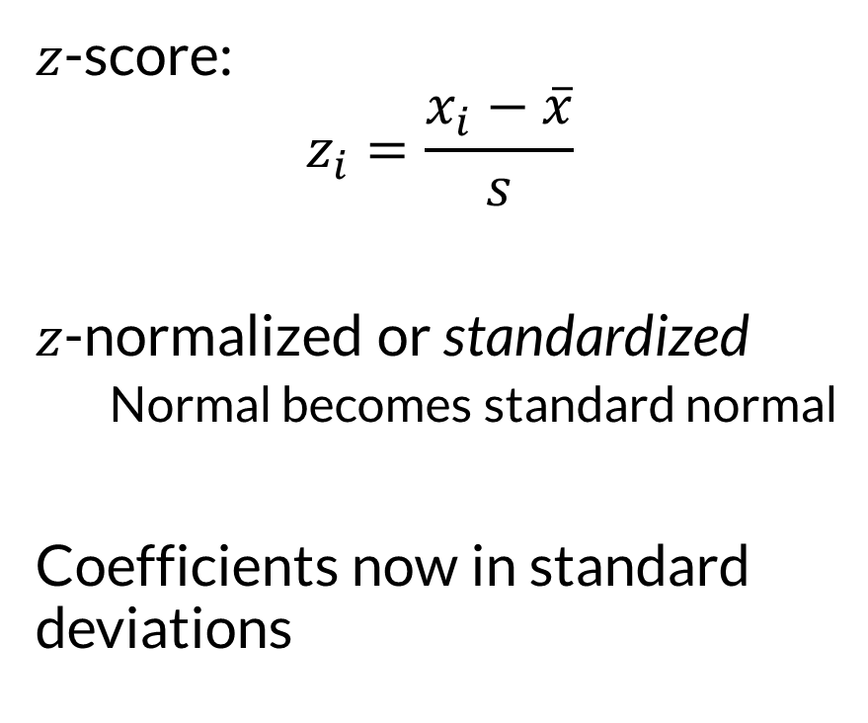
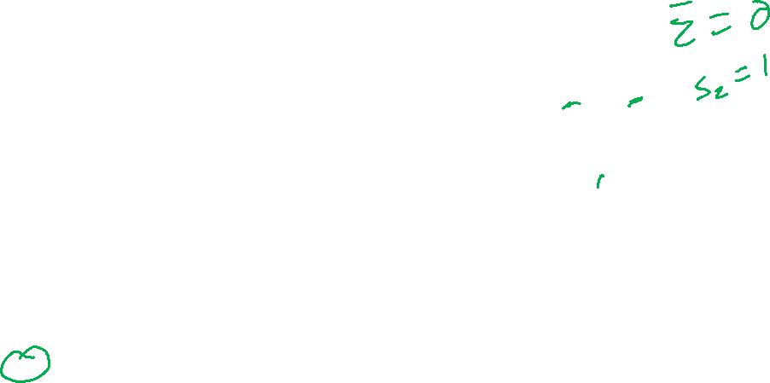
Penguins
$z$-score:
$$z_{i}=\frac{x_{i}−\overline{x}}{s}$$
$z$-normalized or standardized
Normal becomes standard normal
Coefficients now in standard deviations

Slide 11

Wrapping Up
Linear regression predicts one variable with another using a linear relationship.
Inference makes several key assumptions.
Standardizing variables puts coefficients in units of standard deviations.
Photo by Gemma Evans on Unsplash

